Slide 1
For Your Grammy® 2026 Consideration
Best Global Music Performance / Record of the Year / Song of the Year
For Your Grammy® 2026 Consideration
Best Global Music Performance / Record of the Year / Song of the Year
The Myth of Eve

Slide 2
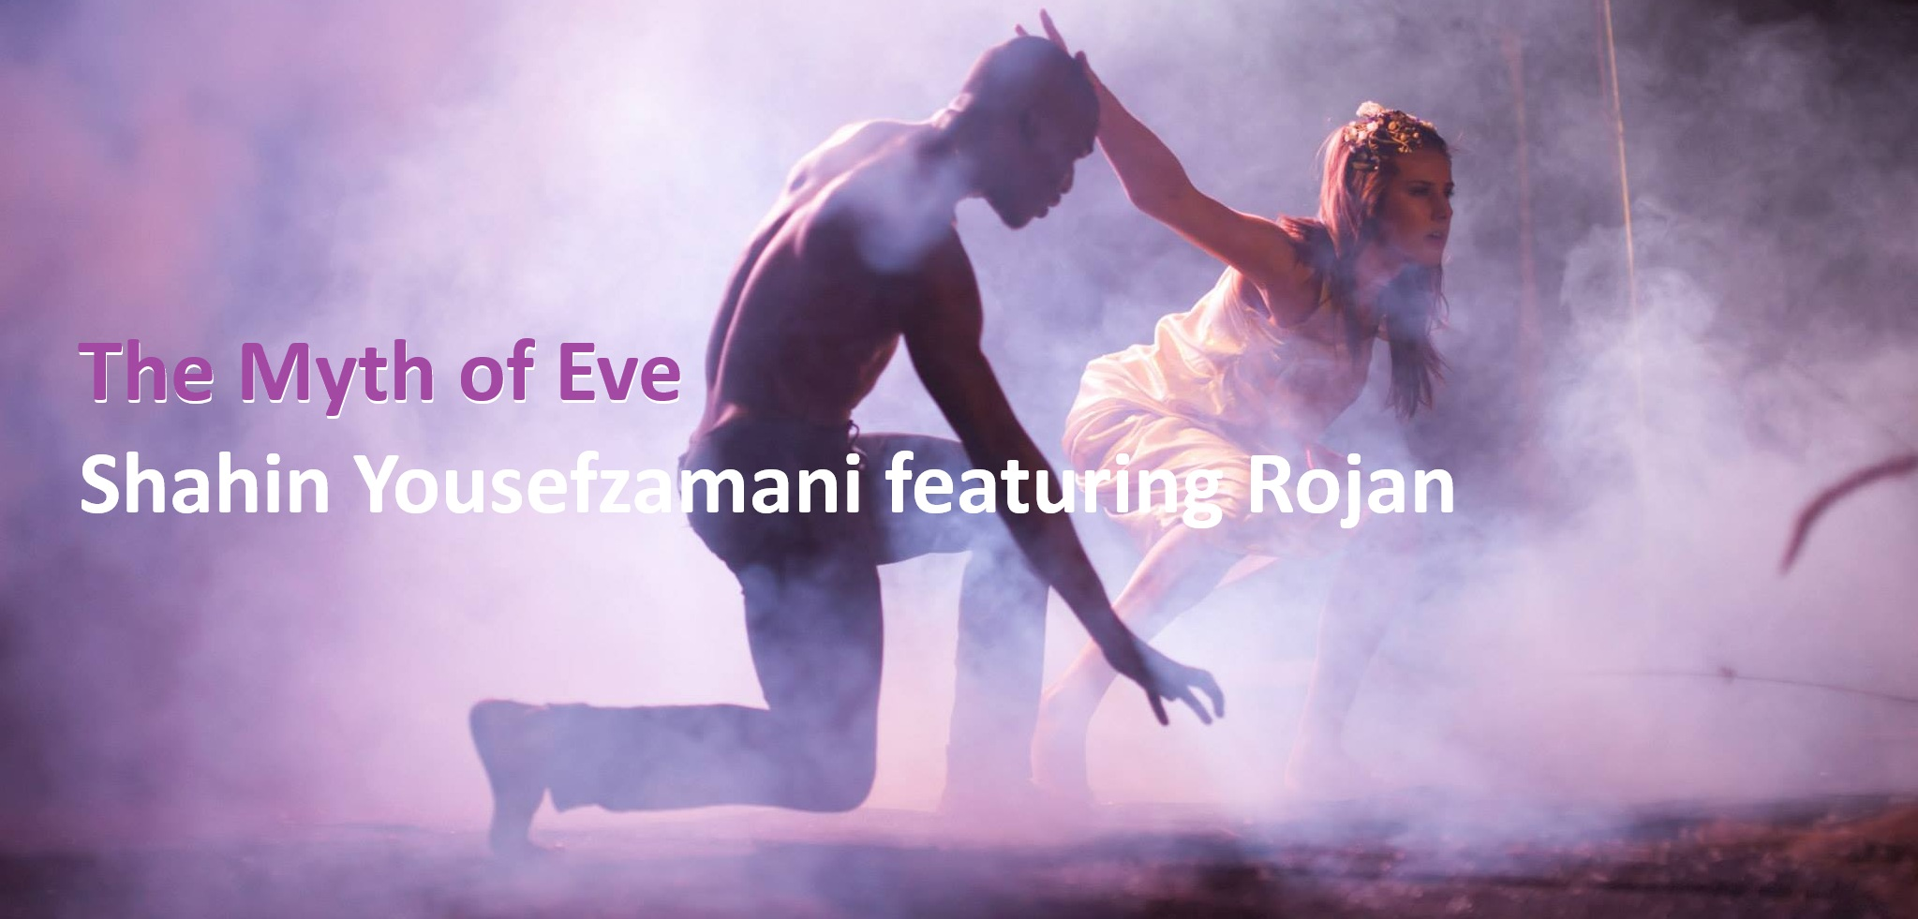
It is a great honor to announce that the song “The Myth of Eve”, composed by Shahin Yousefzamani and performed by Rojan, is officially on the path to the Grammy Awards 2026.

Slide 3
Description
“The Myth of Eve”
reflects the silent suffering that war has imposed on mothers and pregnant women throughout history—the first unseen victims of every conflict, beyond religion or borders, yet ever present in the heart of human history.

Slide 4
Lyrics
[Translated from Farsi]
This scattered crowd, though it holds no tribe / Clings to a name, for it has no family
Too late—brothers show no mercy to brothers / No clan has ever held so many Cains
The world is but pregnant with cruelty and death / As though the heavens bore no seed of Abel
Each killing, an assault on the myth of Eve / Her endurance shatters beneath imposed burdens
If history is but the tale of seasons repeating / My calendar and its calamities know no recess
For the end of love is neither blasphemy nor faith / Even Satan feels no haste in deceiving you
The confusion is ours—yet the story of Adam / Knows neither Qur’anic, nor Toraic, nor Gospel bounds

Slide 5

Watch the Video

Slide 6
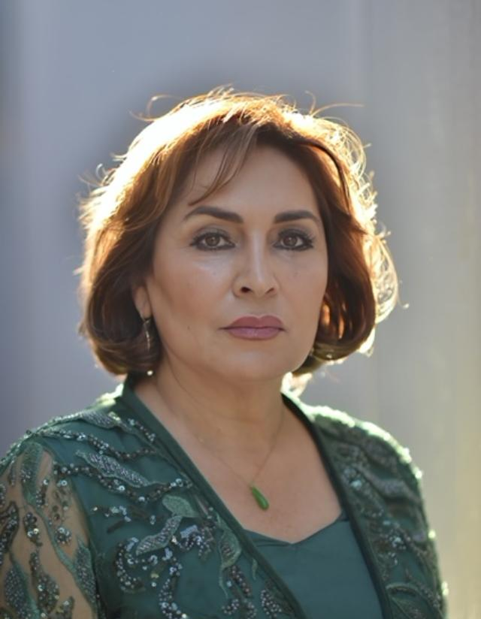
Vocal – Rojan Feyz
Rojan was born in Sanandaj, Kurdestan, into a cultured and music loving family. After high school, Rojan moved to Europe and stayed in Rome, Italy for several years where she attended school for Fashion Design.
Coming home after studying abroad coincides with revolutionary changes in the country. Women, especially artists realize that their social and professional lives need to be changed rapidly, and most of them forced to terminate their public life and artistic activities all together, terrorized by the government agents in private and public. Soon, new Islamic law banned art of singing by female voices.
Rojan started to design colorful pieces again darkness in the background, and practiced music in private. She undertook musical studies with the guidance of Hengameh Akhavan.
In 1999, Rojan and their family immigrated to the US. In the Bay Area San Francisco, where she has been resided with her husband and two children since, for the first time Rojan starts her new professional career as a vocalist with support of their family. After so many years of waiting, all musical activities started including new albums, many concerts and tours.
Rojan in her presentations sings both in Kurdish, and Persian. As a Kurdish singer, Rojan actively has been introducing Kurdish music and traditional clothes, especially in academic centers.
In 2004, Rojan with Shams Orchestra traveled to Kurdistan [Iraq], where they started a tour of 30 concerts around the world.
In 2009, in support of the upraising of Iranian people for democracy, “Green Movement”, Rojan organized several events and recorded some of the traditional resistance folk songs.
Through the years, Rojan’s active participation in International festivals and concerts has been introducing the Kurdish music and culture and creating interest for it among people of different countries.
In the last twenty years, more than 20 songs have been produced by Rojan. She is an artist committed to the interests of people and society.
Visit Rojan's Website

Slide 7
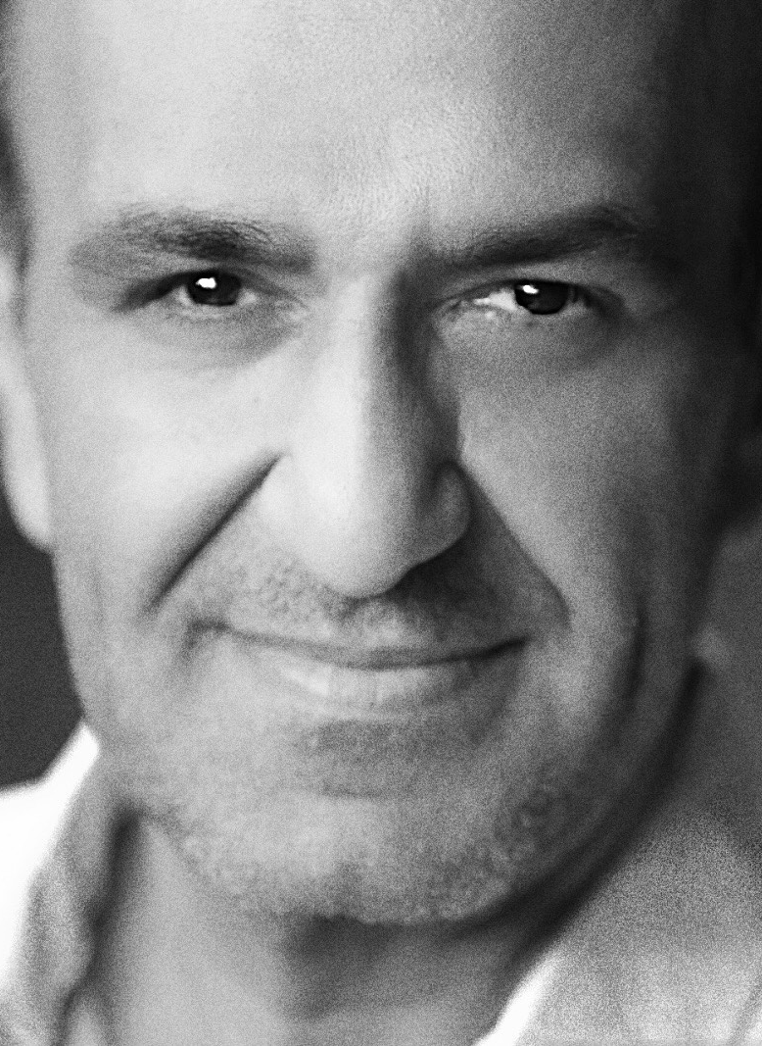
Music Composer – Shahin Yousefzamani
Shahin Yousefzamani was born in Iran. He graduated from Tehran Conservatory and performed with Tehran Symphony Orchestra from 1992 to 2005. He has performed internationally with many renowned artists including Mohammad Reza Shajarian, Iraj Bastami, Khashayar Estemadi, and Alireza Assar. Shahin was nominated for his composition “Dasht” in Young Composers Festival that was conducted by Maestro Seiji Ozawa. In 1994, Shahin studied composition with Professor Thomas Christian David. Since 2007, Shahin has performed with many symphony orchestras in Orange and Los Angeles Counties, and toured internationally with the legendary singer, Googoosh. His compositions have been featured on Fox TV Network, as well as National Radio Airplay. Shahin’s top compositions include Dasht that was recorded by Homayoun Shajarian, Fantasia Shoushtari that was conducted and recorded by Professor David, Faghat To that was recorded by pop music group Black Cats, Sarzamin Man that was recorded by the singer Faezeh, and The Myth of Eve that was recorded by singer Rojan.
Visit Shahin's website

Slide 8
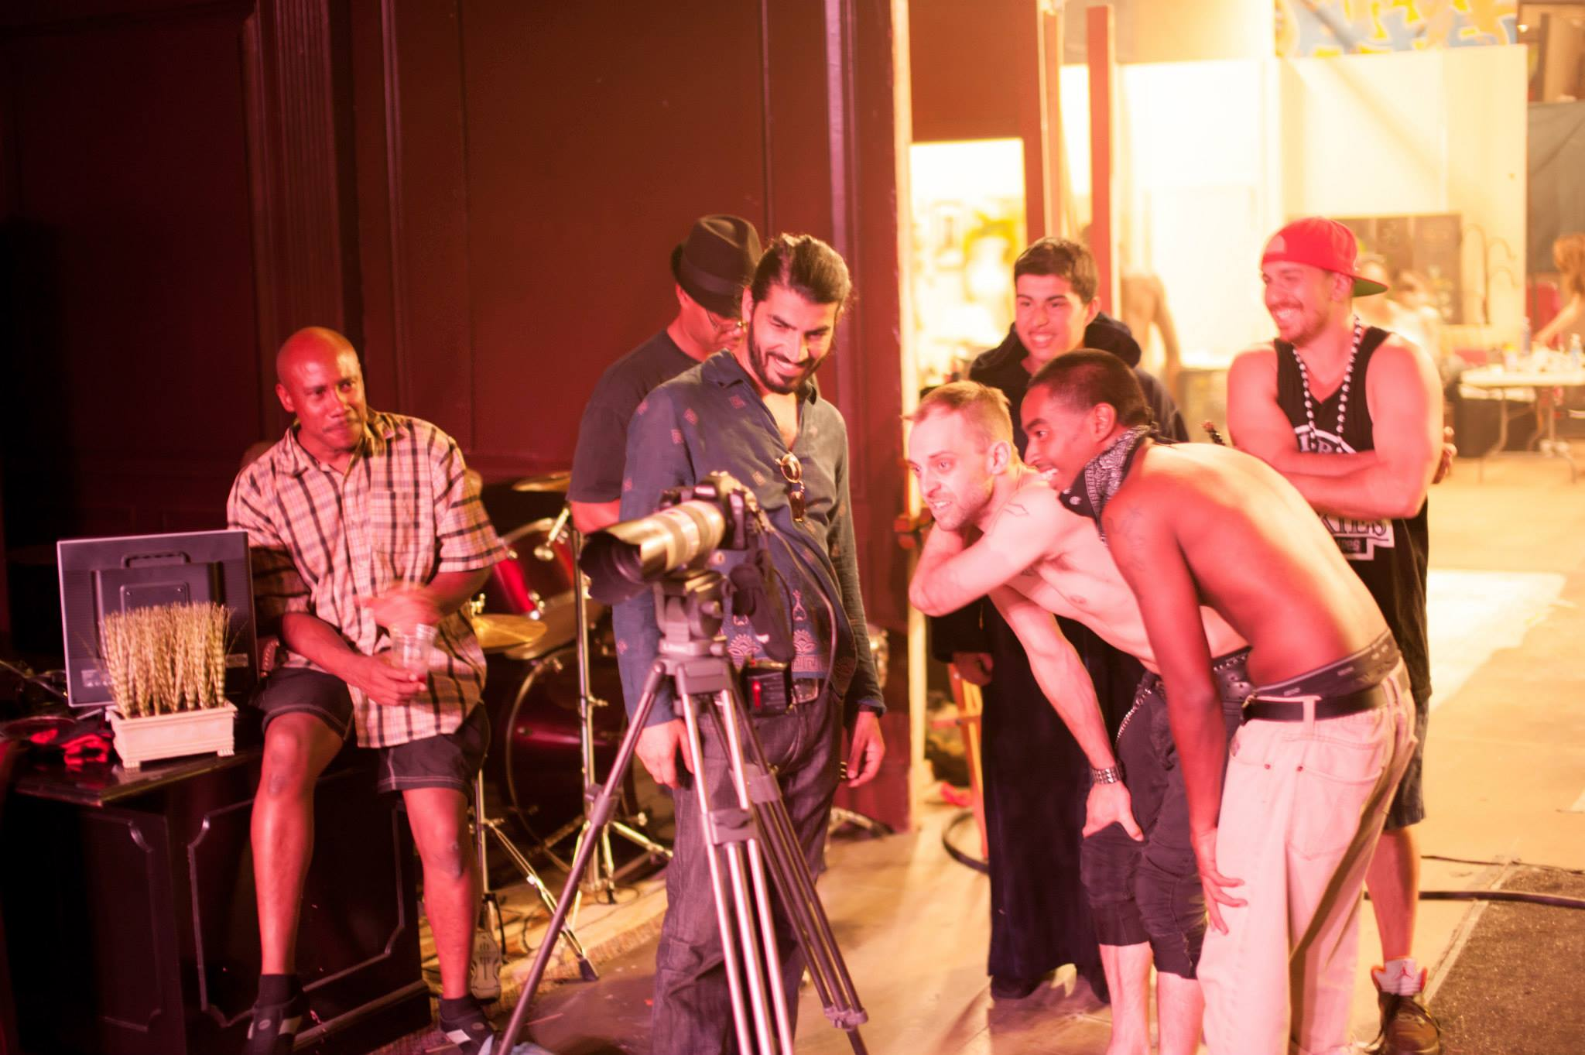
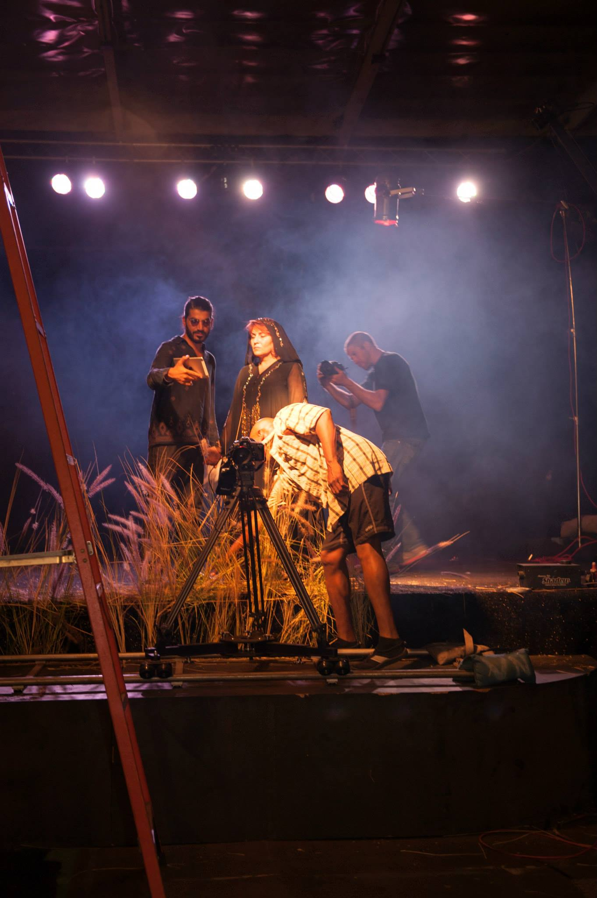
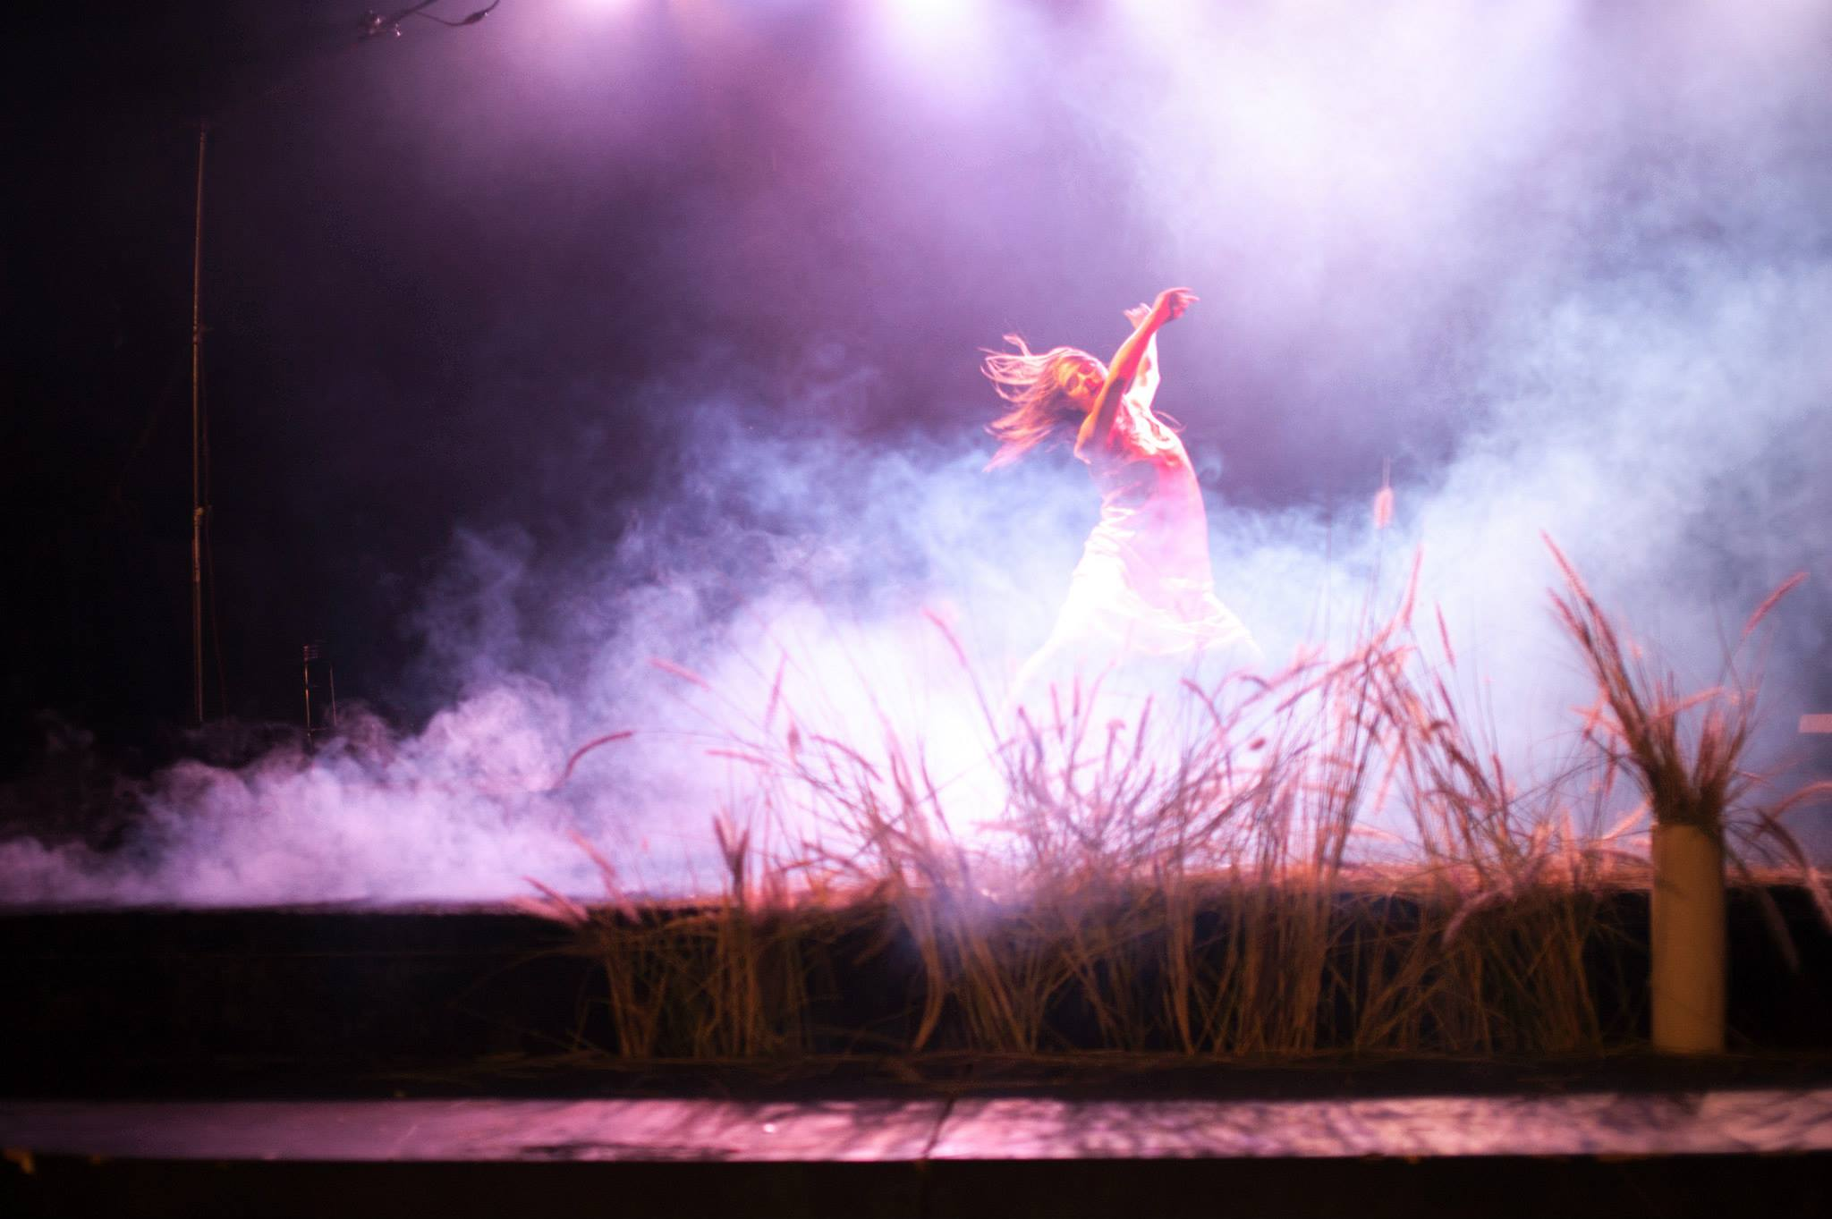
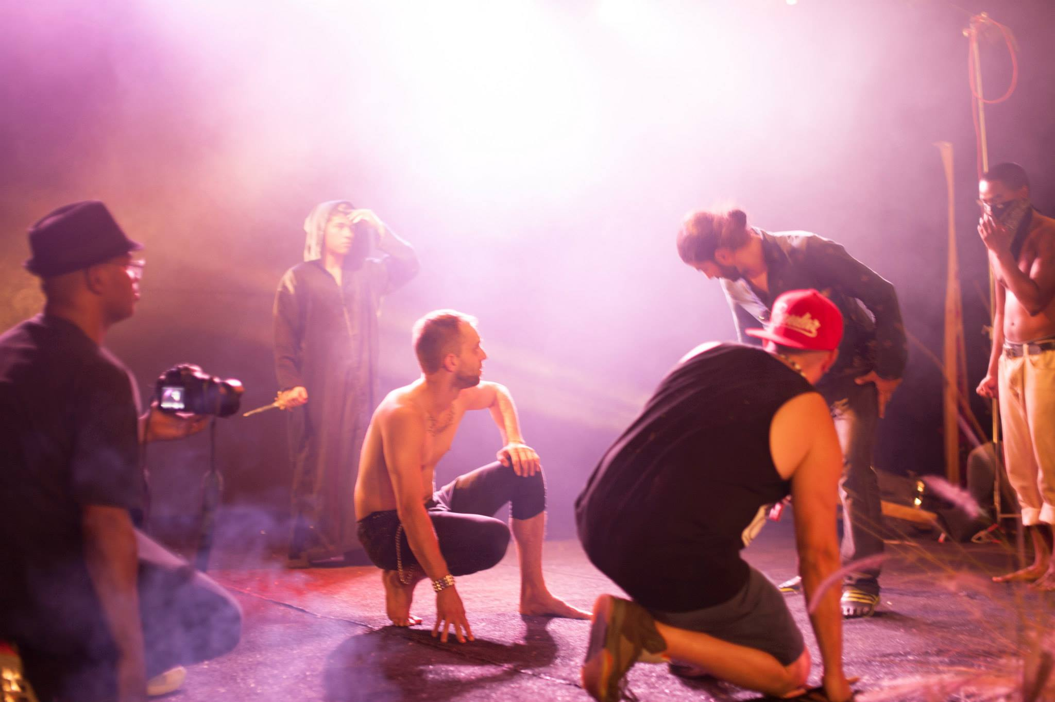
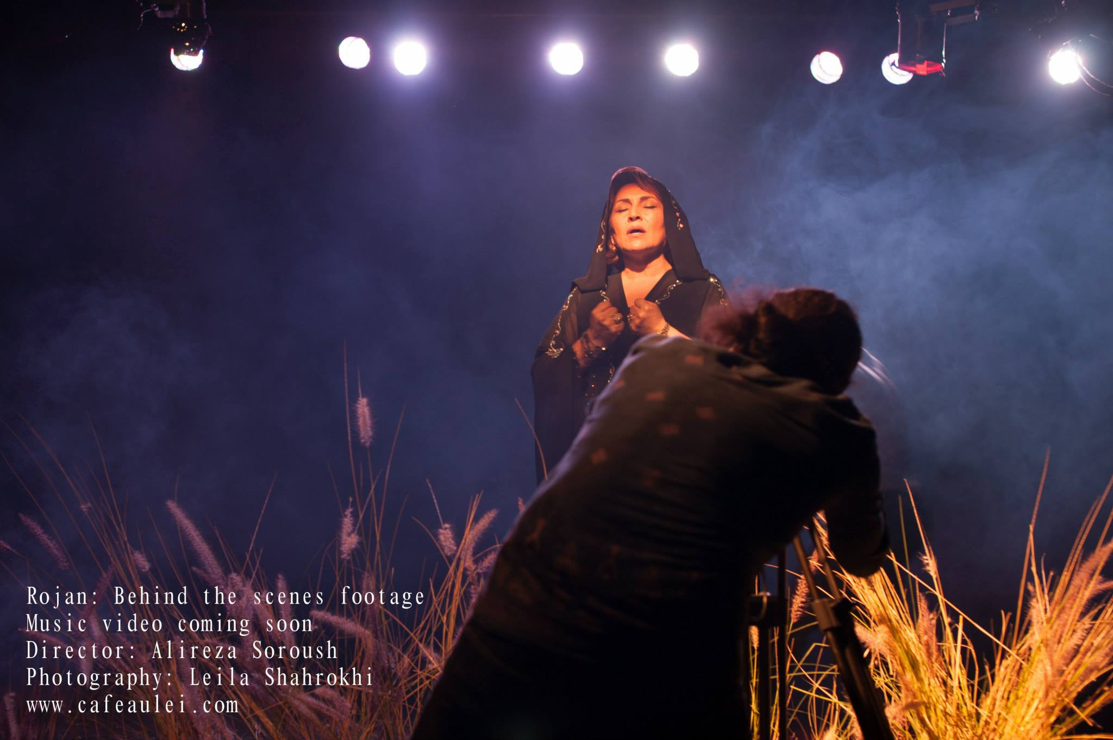
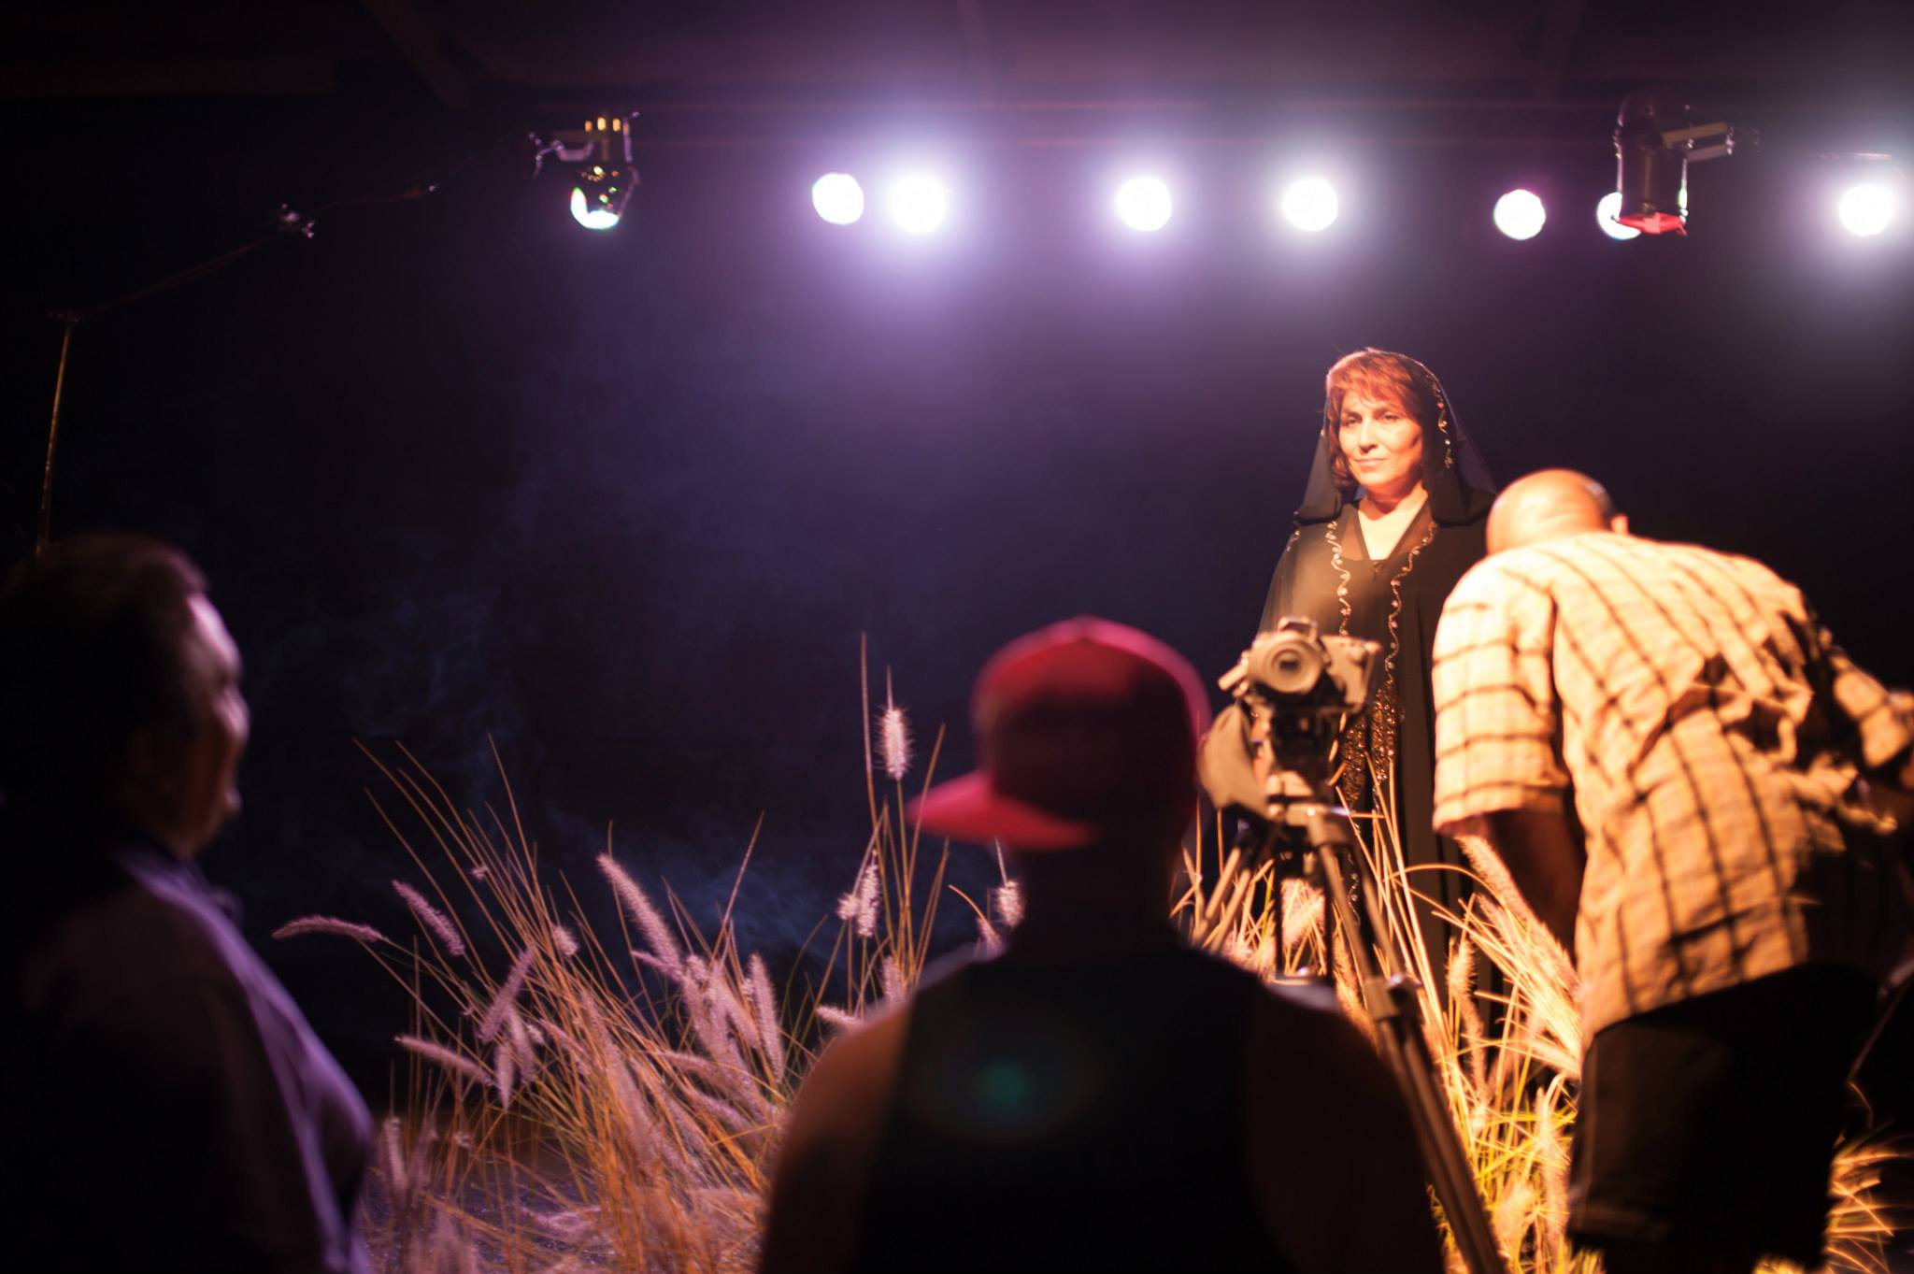
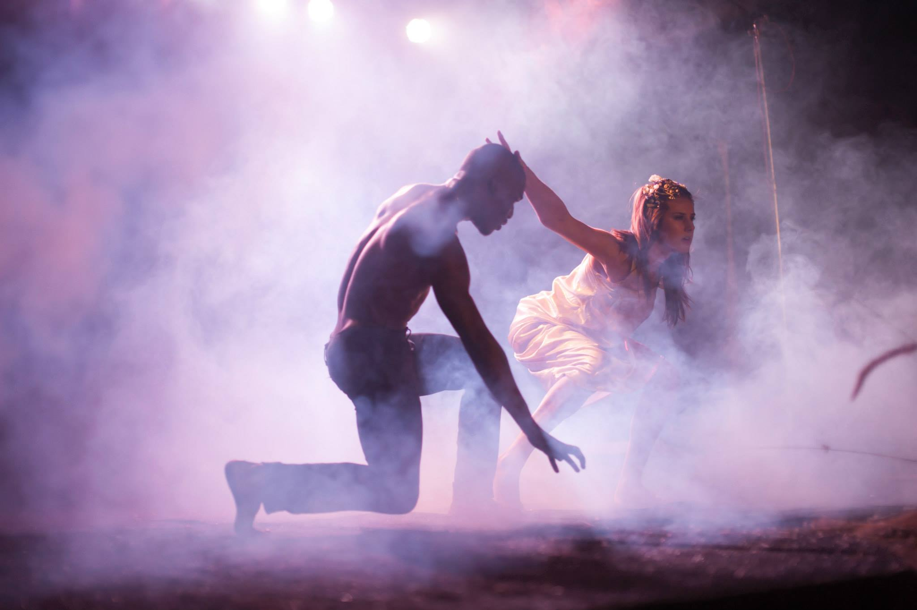
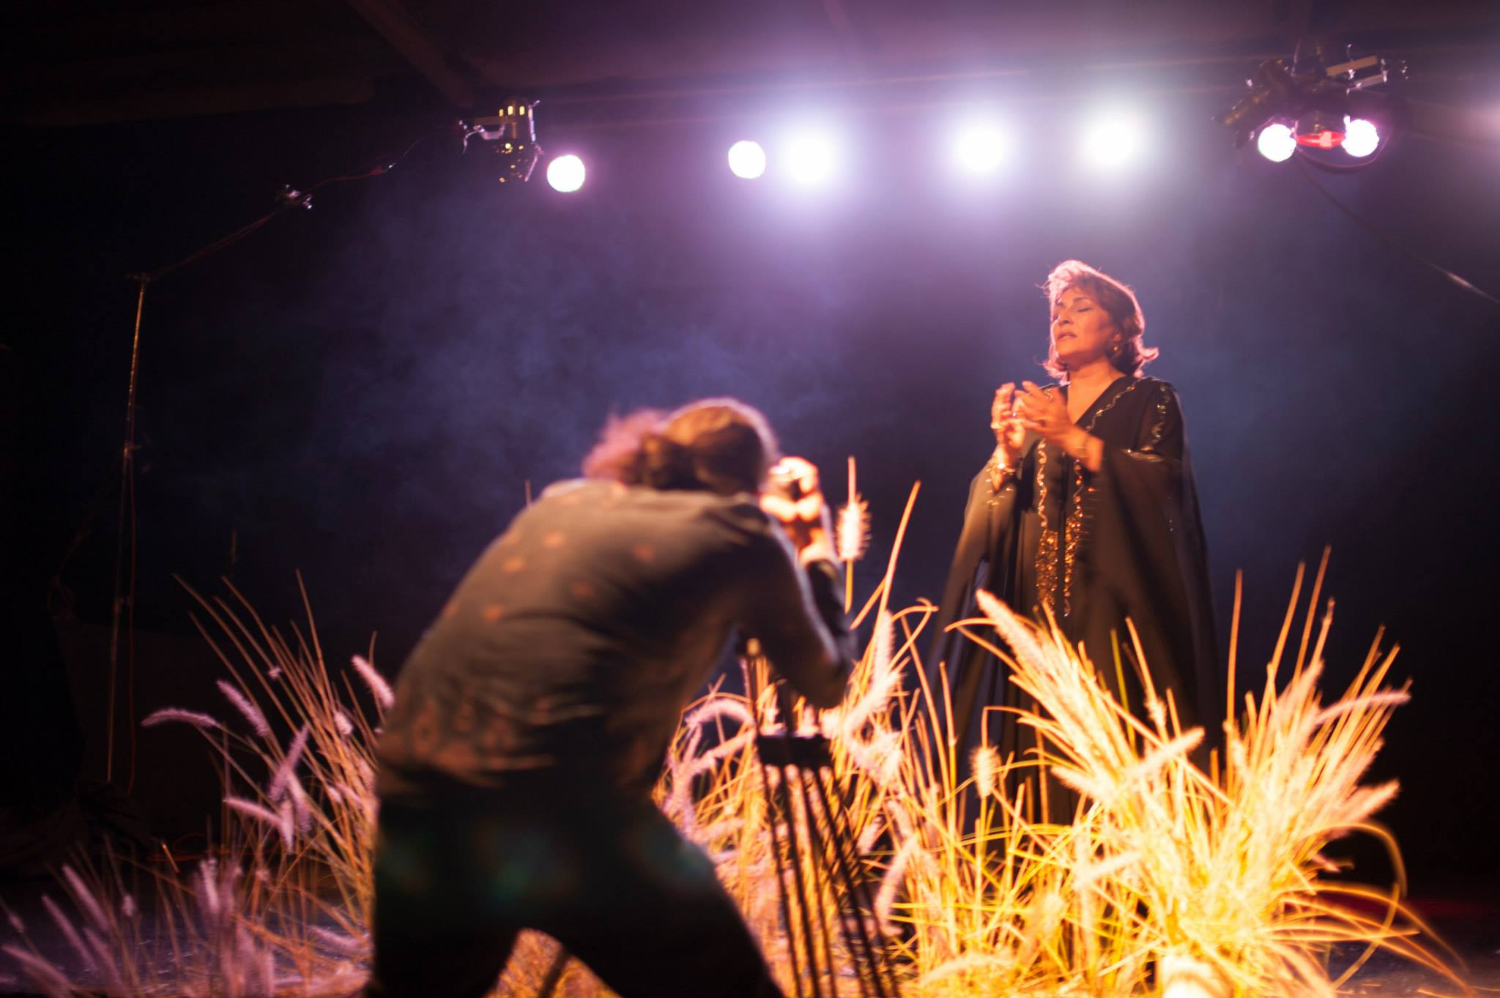
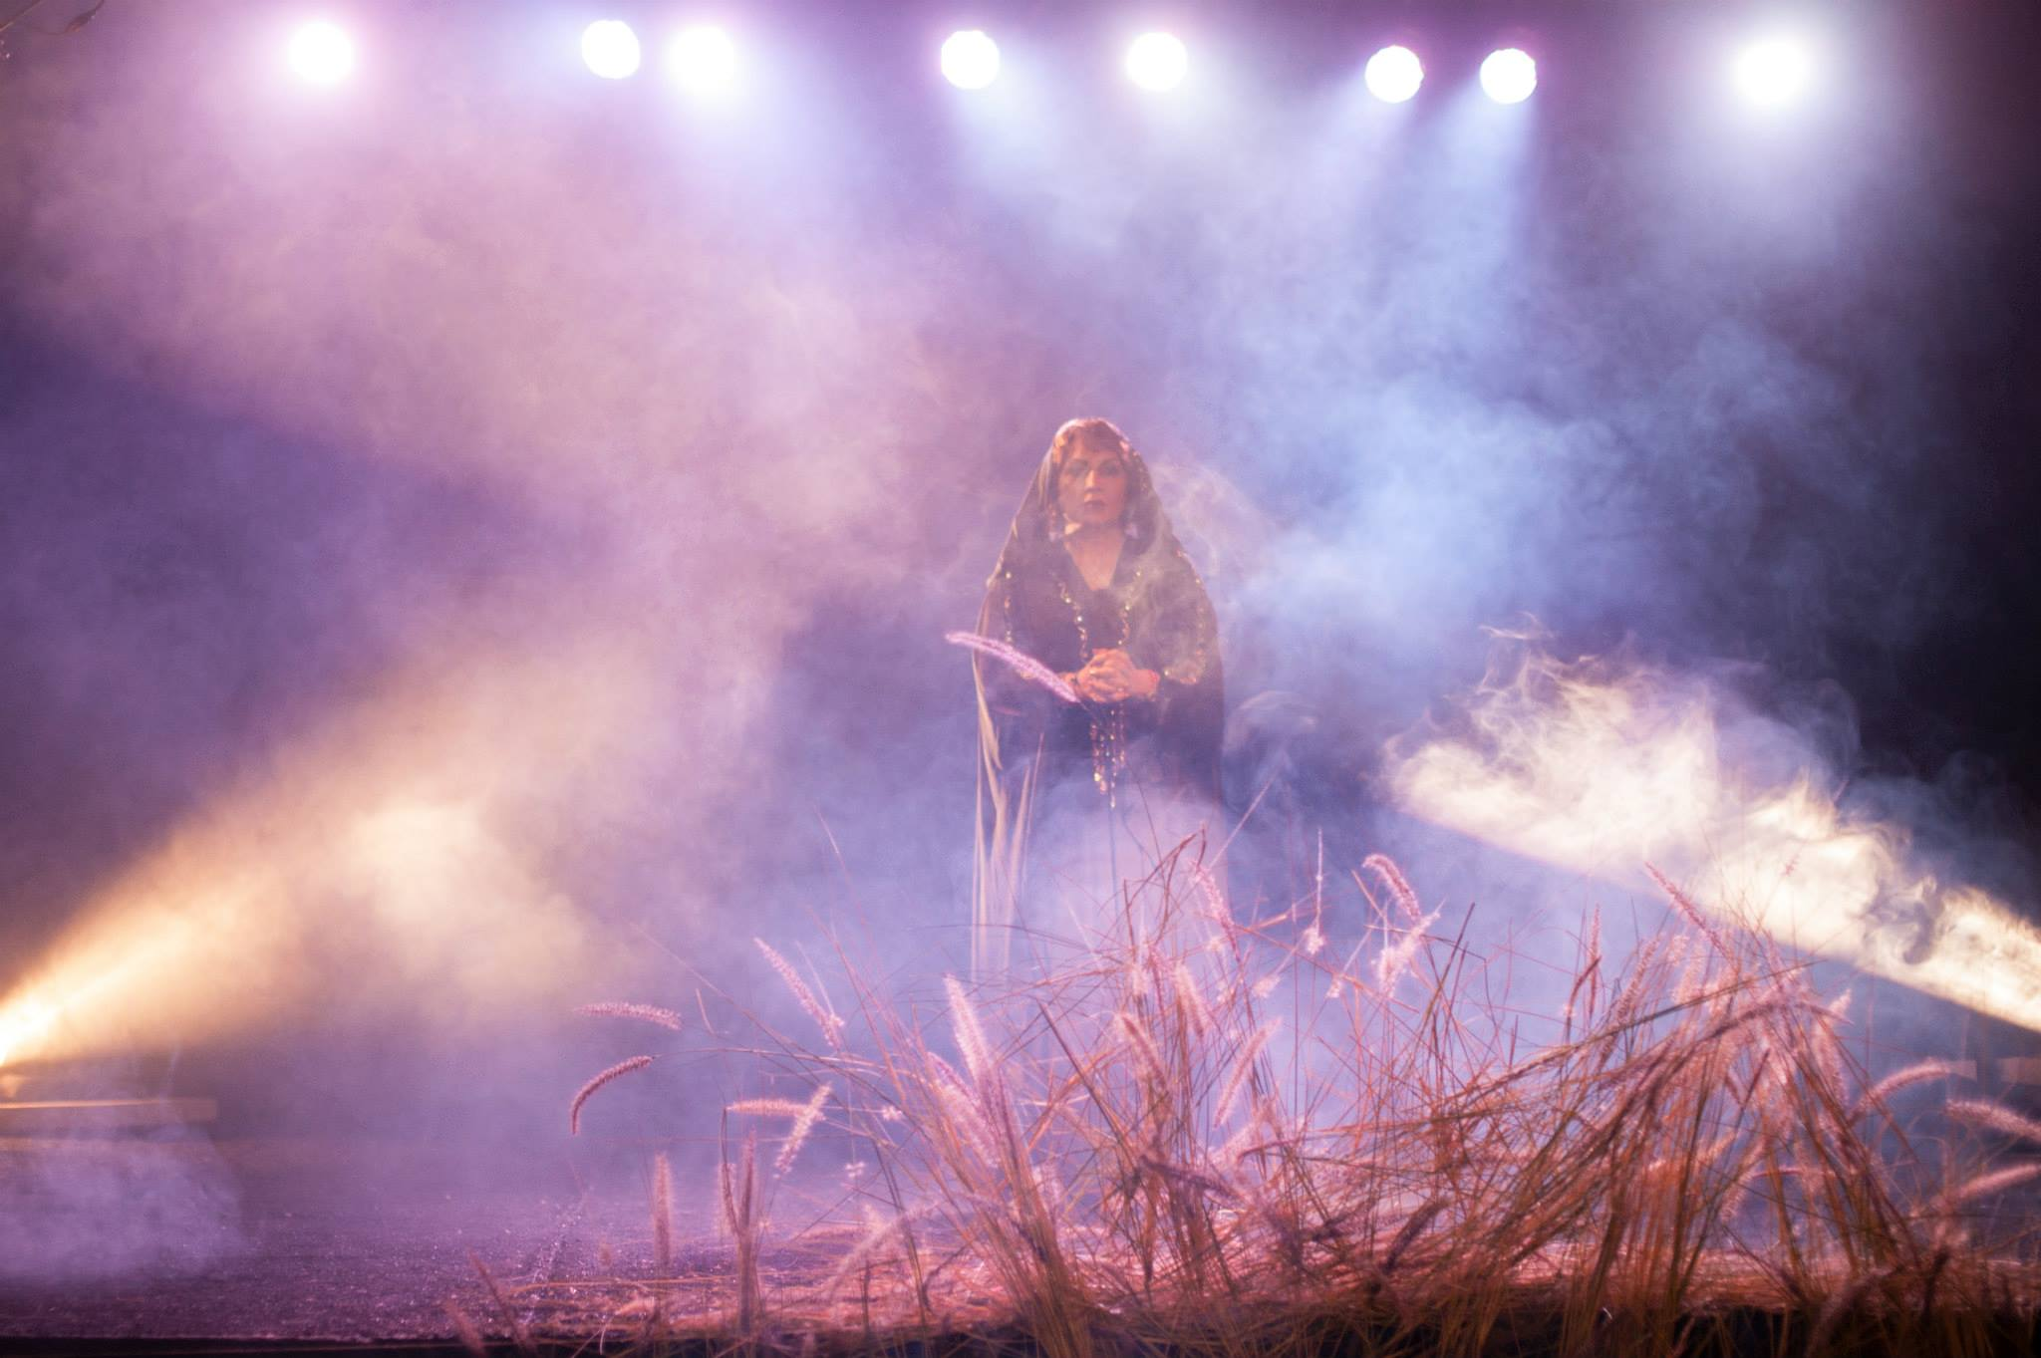
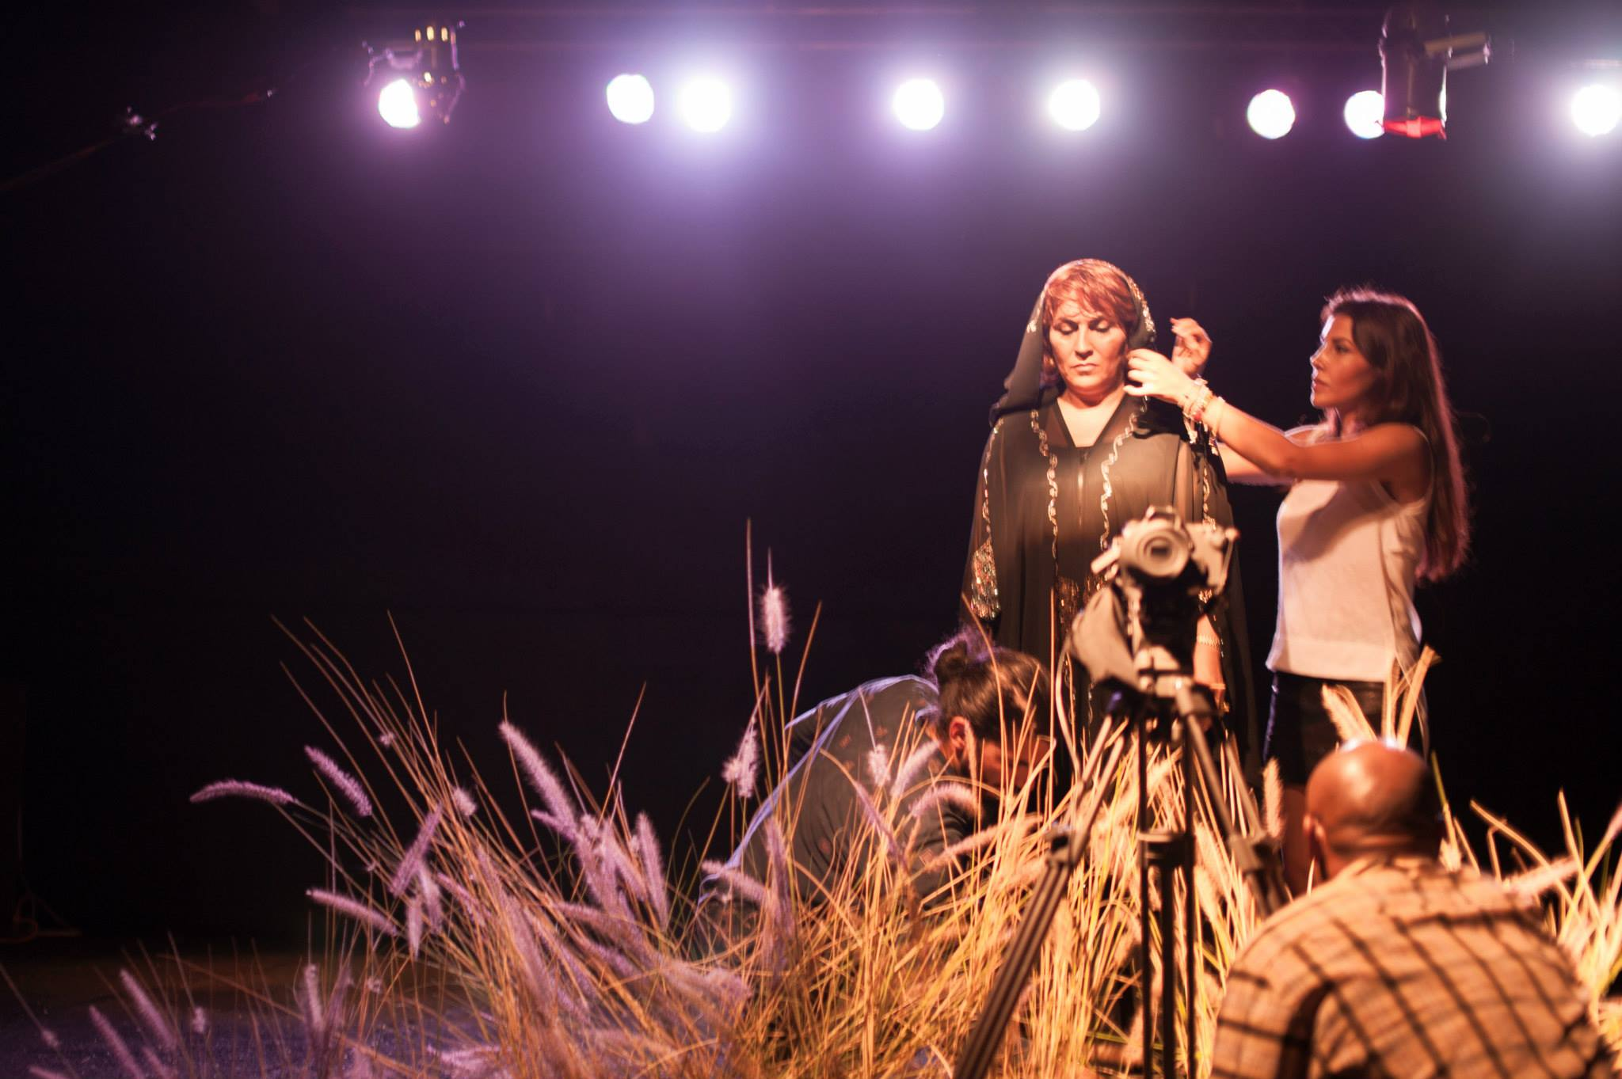

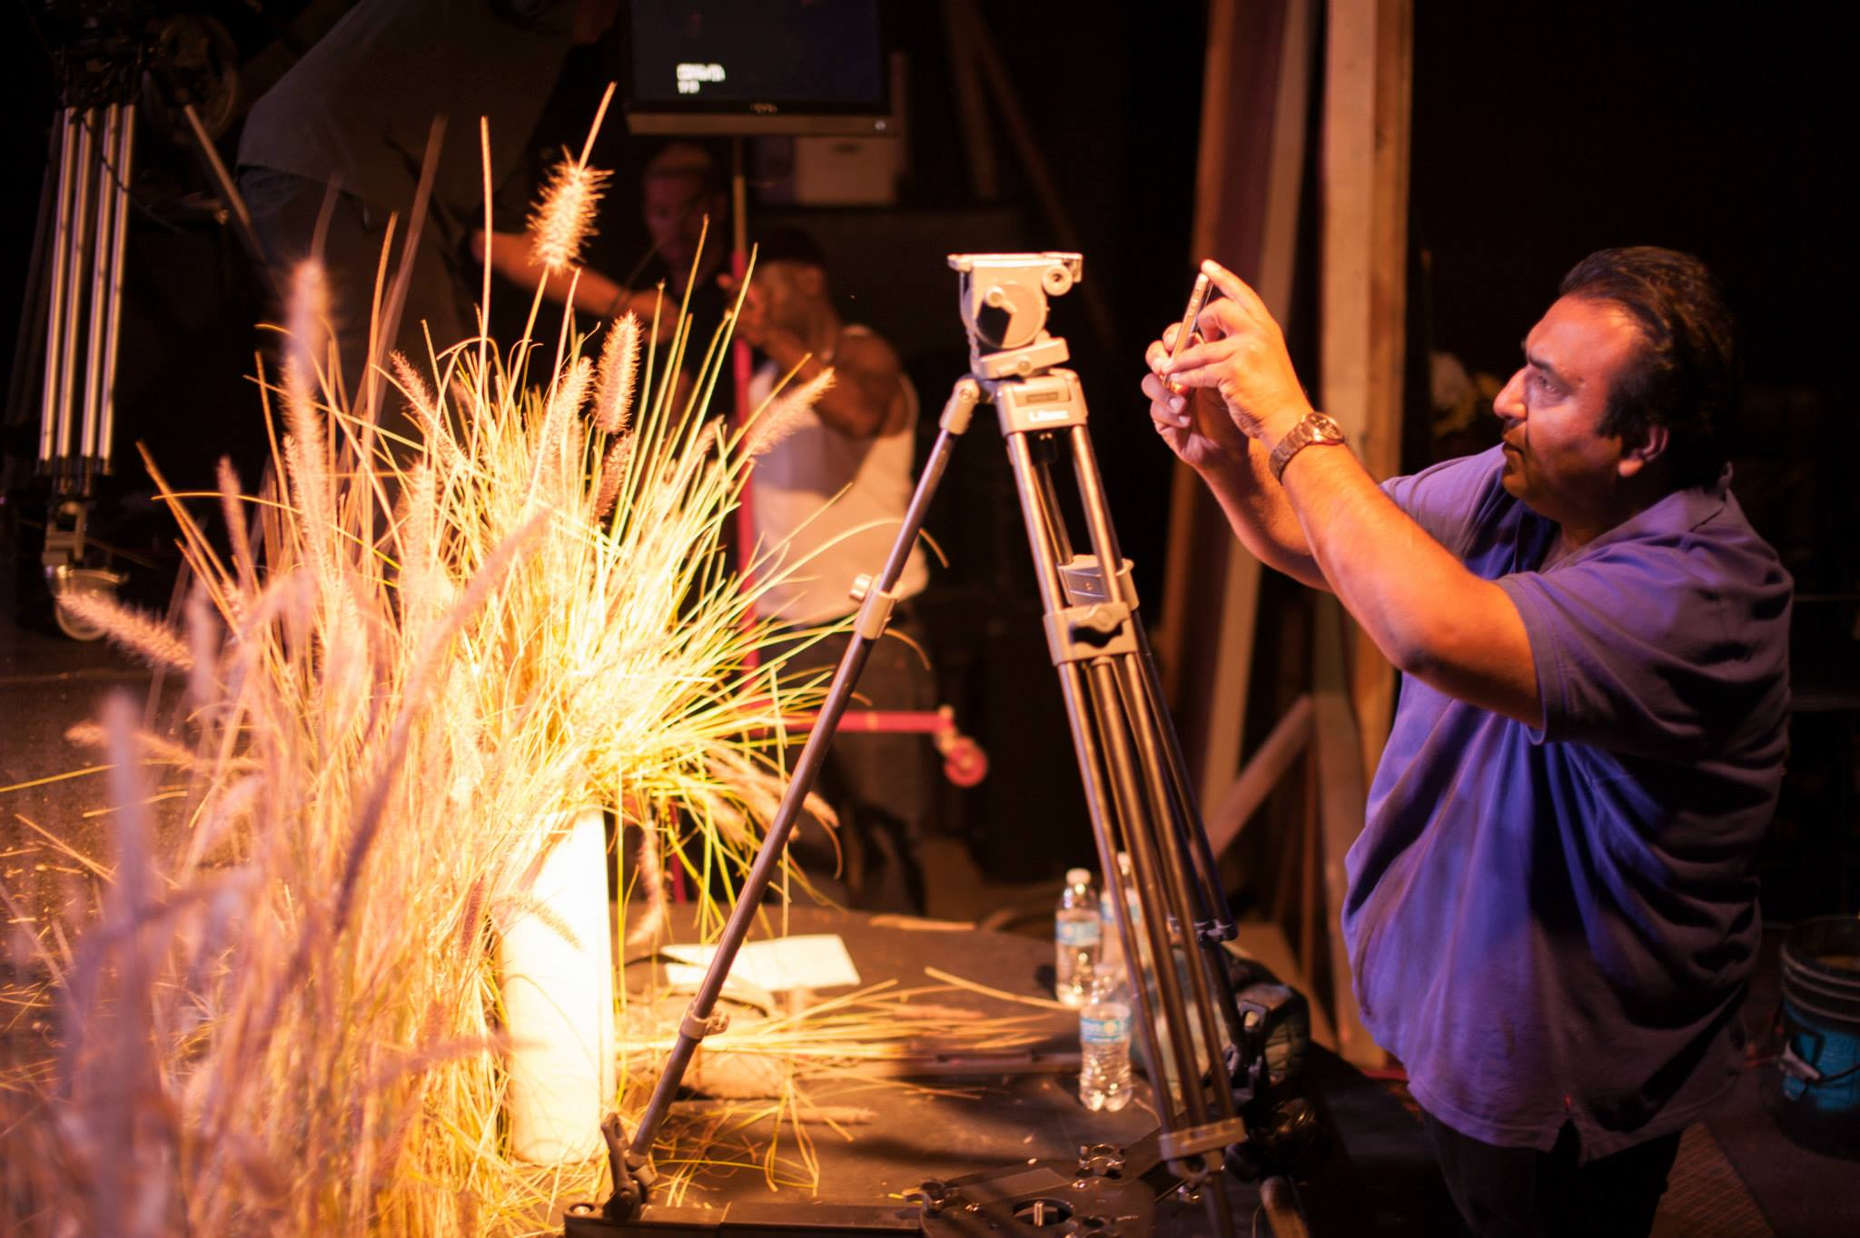
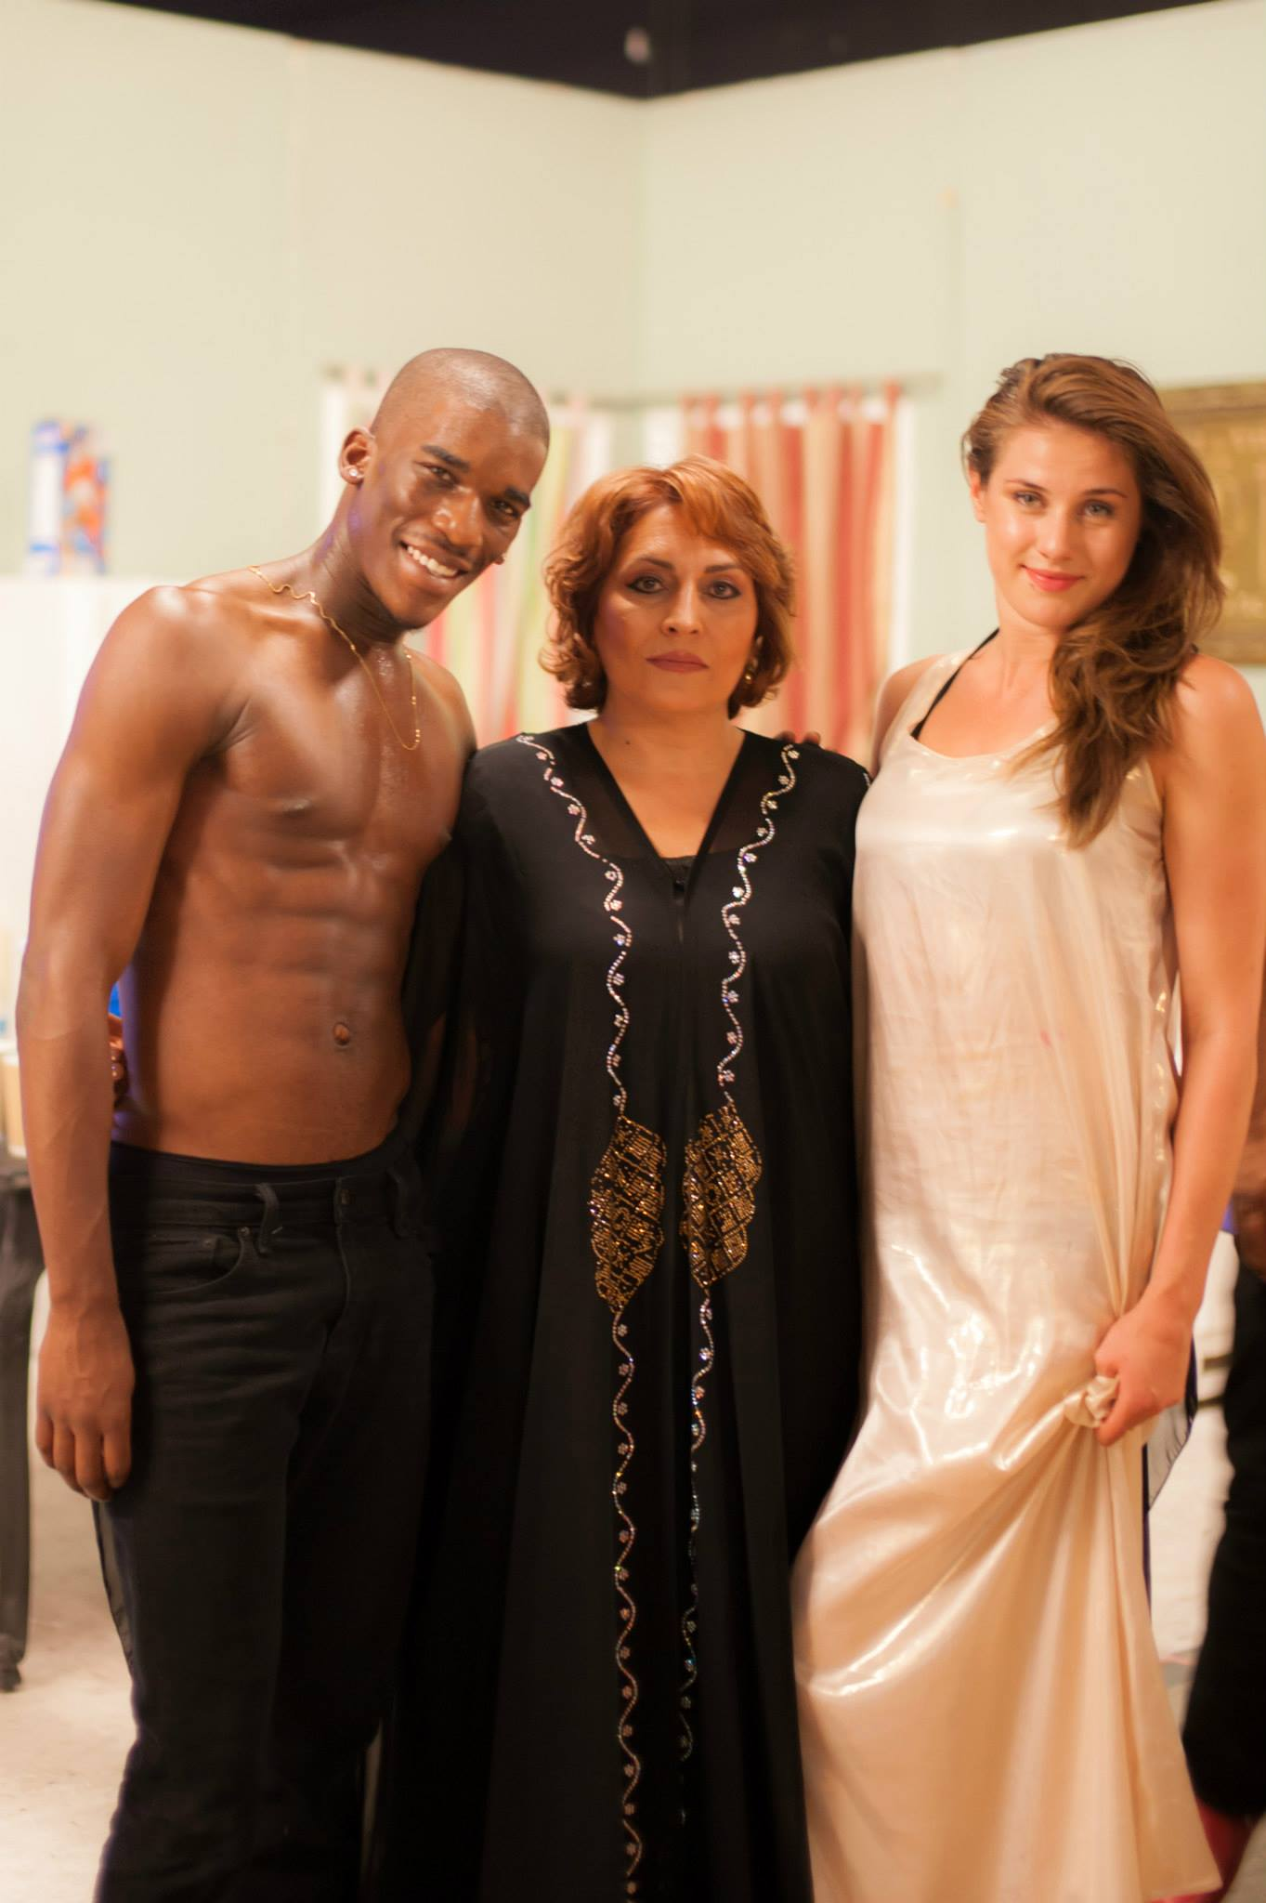
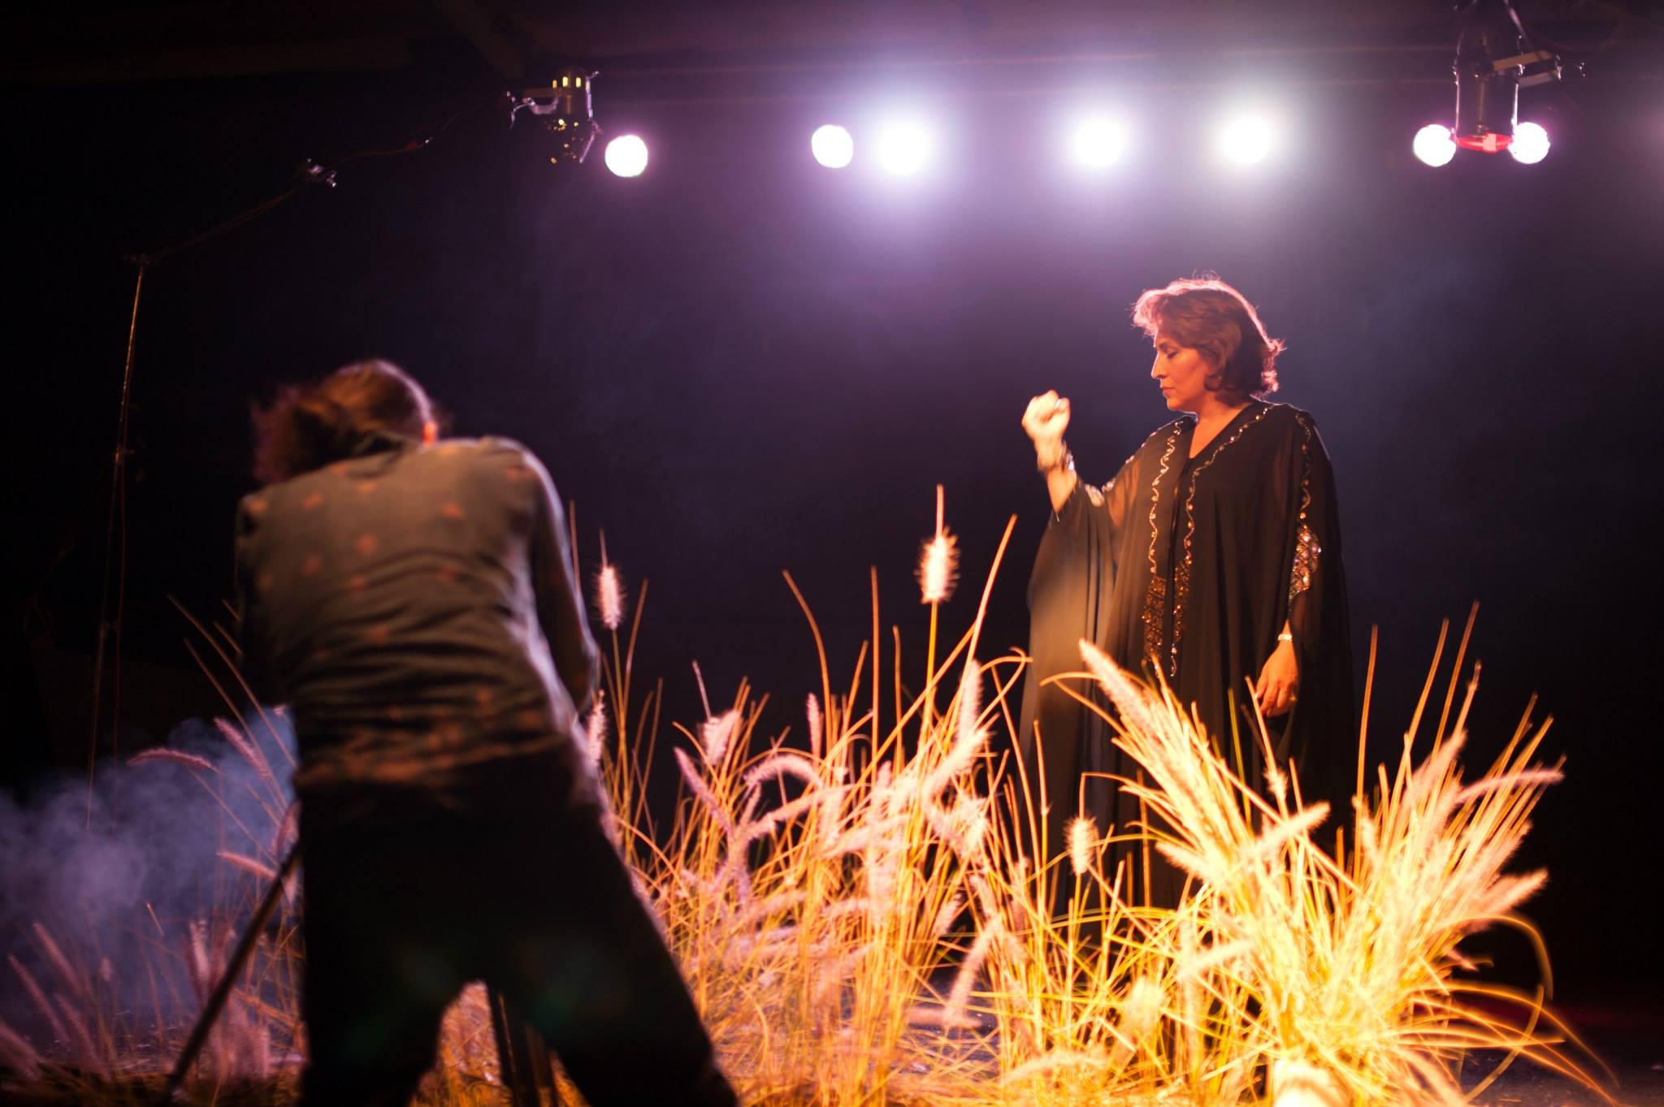
Behind the scene

Slide 9
Credits
Music Composer: SHAHIN YOUSEFZAMANI
Vocal: ROJAN
Lyrics: AFSHIN YADOLLAHI
Orchestra: RASA ENSEMBLE
Ney: PASHA HANJANI
Kamancheh: SINA JAHAN ABADI

Slide 10
Contact Info.
Shahin Yousefzamani
E-mail: shyousefzamani@gmail.com
Phone: (310) 849-4641
Rojan
E-mail: rojan.feyz@yahoo.com
More information: TheMythOfEve.com

Slide 11
Visit the Website
https://www.TheMythOfEve.com

